Slide 1
Practical No-8
VLSM
(Variable length subnet mask )

Slide 2
What is Subnetting?
Subnetting means dividing a network into multiple small networks. We use subnetting mainly to save the wastage of IP addresses. We will be discussing here the subnetting of classful addressing. There are two types of subnetting,
FLSM (Fixed Length Subnet Mask)
VLSM (Variable Length Subnet Mask)

Slide 3
What is VLSM?
Variable Length Subnet Mask (VLSM) is a technique used in IP network design to create subnets with different subnet masks.
VLSM allows network administrators to allocate IP addresses more efficiently and effectively, by using smaller subnet masks for subnets with fewer hosts and larger subnet masks for subnets with more hosts.

Slide 4
Example of subnetting 10.0.0.1/26
Step -1 The value of 64 hosts is 2^{6.}
^{Step -2 -}
Total bits - Subnetting mask = 32- 26 = 6 bits.
Step -3 – IPv4 is 32 bits, divided into 4 equal parts.
8 +8+8 + 11000000 = 128 +64 =192.
Step -4 - Find the host addresses.
^{255- 192 = 63.}
The network range we can give to network hosts is from 0 to 63.
^{Subnet mask = 255.255.255.192.}

Slide 5
How to find the Host address.
Network ID is - 10.0.0.1/26 ,Host addresses – 10.0.0.1- 10.0.0.62
Broadcast Id - 10.0.0.63.
Network ID starts from 10.0.0.64, Host address-10.0.0.65 – 10.0.0.126
Broadcast Id – 10.0.0.127.
Network ID Starts from 10.0.0.128,Host Address – 10.0.0.129 - 10.0.0.190,
Broadcast ID – 10.0.0.191.
Network ID Starts from 10.0.0.192 ,Host Address – 10.0.0.193 - 10.0.0.254,
Broadcast ID – 10.0.0.255.

Slide 6
IP Address: 1.0.0.1/2
Step -1 The value of 2 hosts is 2^{1.}
^{Step -2 -}
Total bits - Subnetting mask = 32- 2 = 30 bits.
Step -3 – IPv4 is 32 bits, divided into 4 equal parts.
⁸ ⁺⁸⁺⁸ ⁺ ¹¹¹¹¹¹⁰⁰ ⁼ ¹²⁸
Step -4 - Find the host addresses.
^{255- 128 = 127.}
The network range we can give to network hosts is from 0 to 127.
Subnet mask = 255.255.255. 128.

Slide 7
Implementation of VLSM by giving the Network ID -192.168.10.0, SM=255.255.255.192
The formula for finding the host addresses = 255- 192 = 63 hosts.
Network ID is - 192.168 .10.0 ,Host addresses – 192.168.10.1- 192.168.10.62
Broadcast Id - 192.168.10.63.
Network ID starts from 192.168.10.64, SM -255.255.255.224
The formula for finding the host addresses = 255- 224 = 31 hosts.
Host addresses- 192.168.10.65 – 192.168.10.94, Broadcast Id - 192.168.10.95.
Network ID starts from 192.168.10.96, SM -255.255.255.252
The formula for finding the host addresses = 255- 252 = 3 hosts.
Host addresses- 192.168.10. 96 – 192.168.10.98, Broadcast Id - 192.168.10.99.

Slide 8
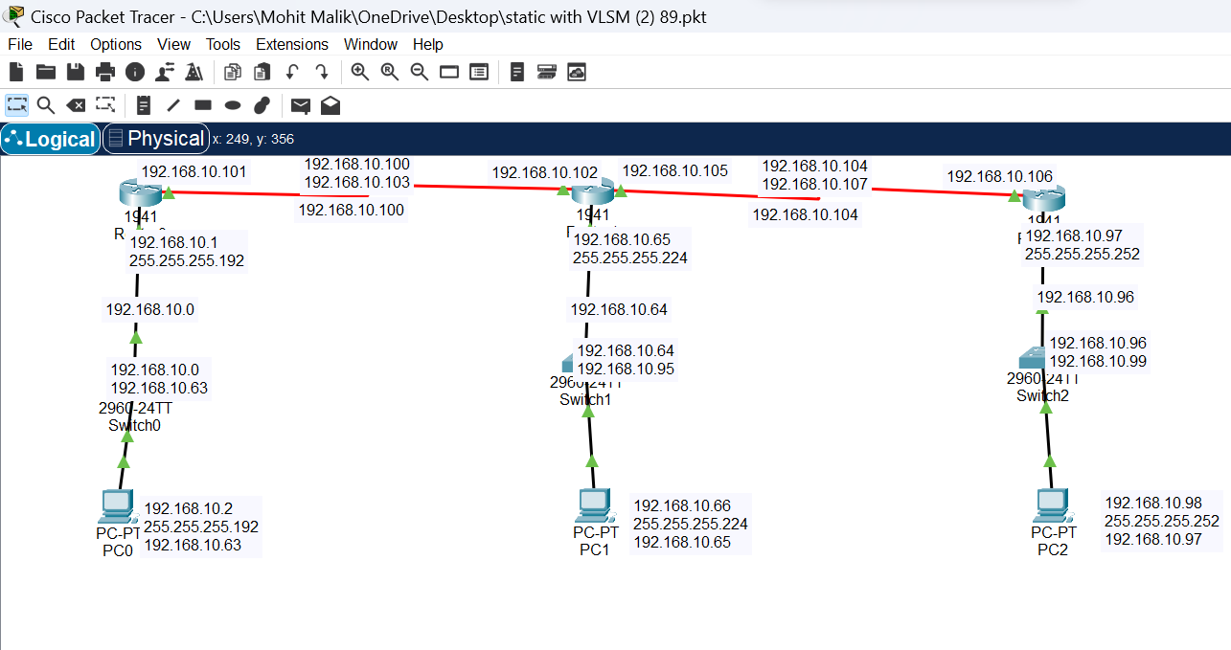
Implementation of VLSM on cisco packet tracer.

Slide 9
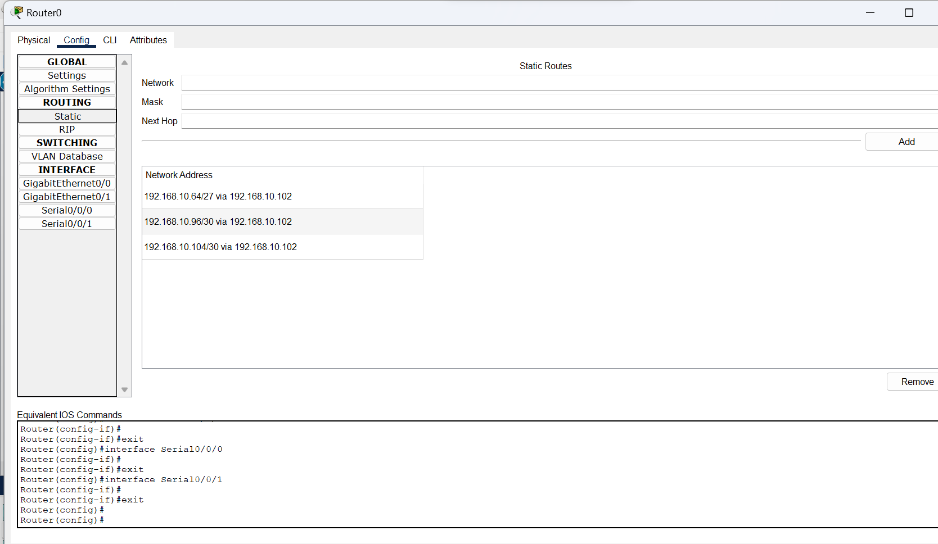

Slide 10
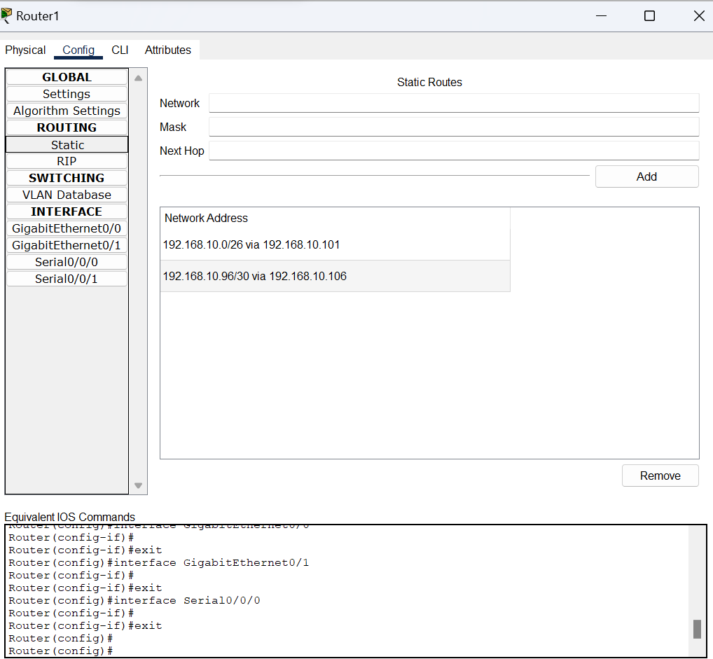

Slide 11
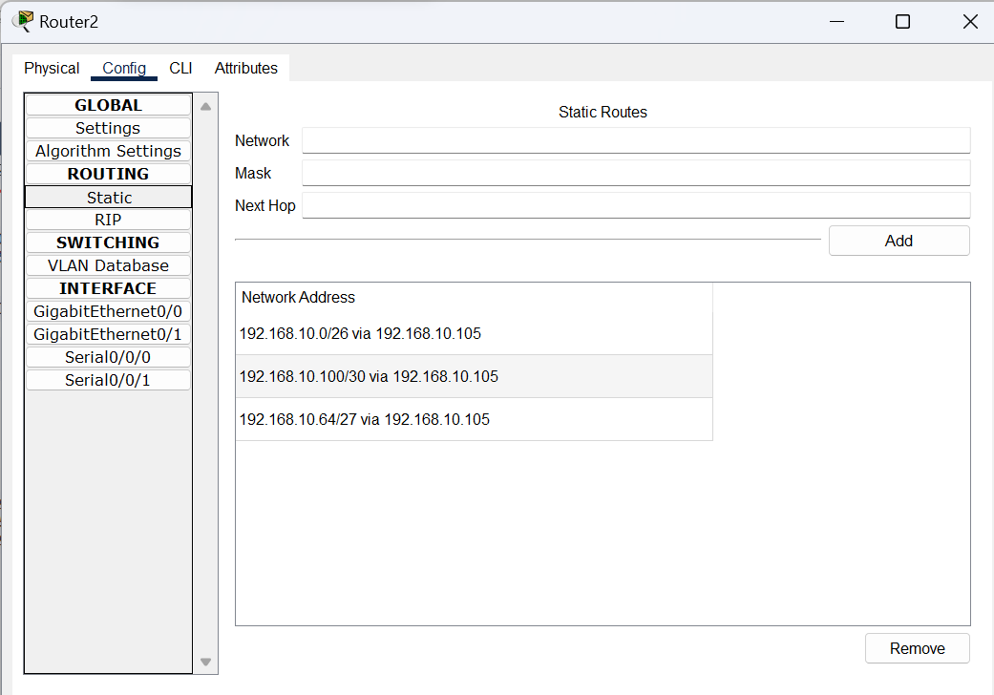

Slide 12
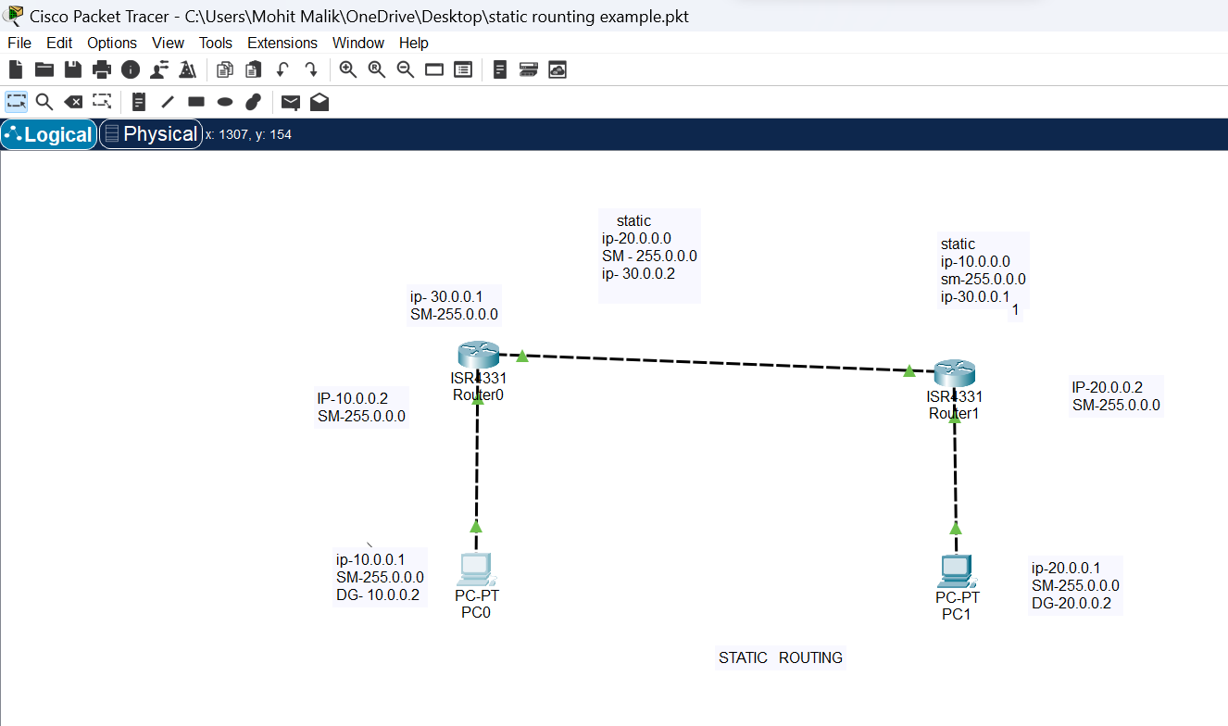
Concept of Static Routing

Slide 13
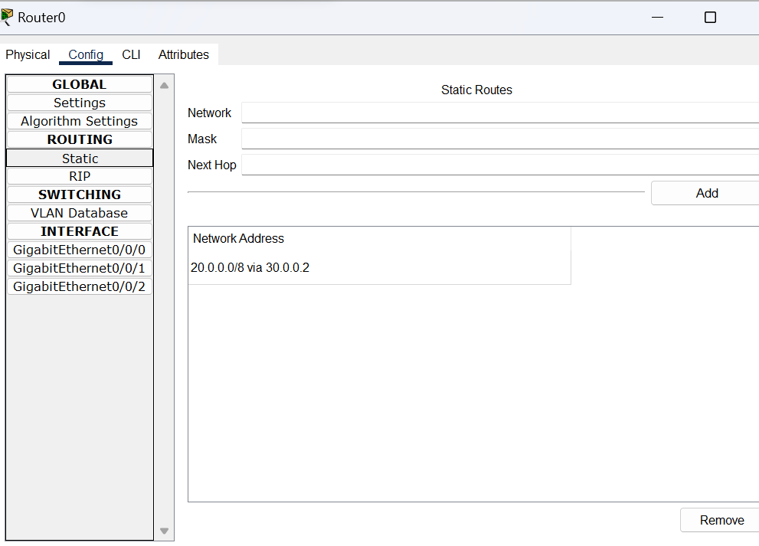

Slide 14
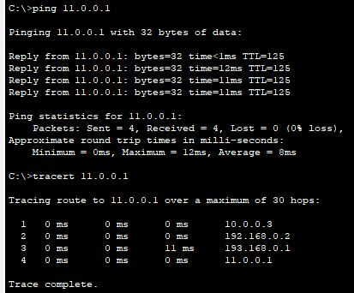
Ping command apply on destination address

Slide 15


